Slide 1
Using gestures alongside words
.

Slide 2
Using gestures alongside words
The clip you are about to see is of Evan (22 months) and his Mum playing with bubbles.
This video will show you how you can use gesture in simple activities to support understanding and use of concepts.

Slide 3
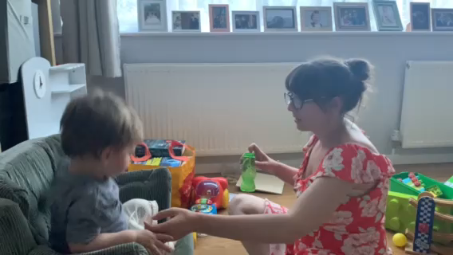
Click the play button under the image to view the video

Slide 4
Did you notice...
Evan used his hands (gesture) to show his Mum that he wanted “big” bubbles.
Mum checked with Evan that he wanted “BIG bubbles?” and emphasised the word ‘big’
Mum used gesture to support Evan to make a choice between “up” and “down” .
Evan asked mum for “big” bubbles by using a gesture.
Mum always used words at the same time as her gestures.

Slide 5
Watch again..
What did mum do to give Evan the chance to say whether he wanted bubbles up or bubbles down?
How did Evan respond?

Slide 6
Watch again..

Slide 7
Did you notice..
Mum checked she knew what Evan meant by saying “bubbles….?”, pointing and then pausing for Evan to reply “up!”.
Evan then made sure Mum knew that he wanted BIG bubbles by telling her this and gesturing.
Mum then put all the words and gestures together, modelling “big bubbles up”

Slide 8
How can I use this in real life?
Think about all the opportunities across your day that you can use gesture to support what you are saying and develop your child’s language. This can be in play or in simple everyday activities such as:
Showing the size of something
Greeting friends/family (waving)
Talking about animals at the farm
Pointing to something that you can see
Modeling action words e.g. driving/eating/waving
Helping to introduce new words
Singing action songs
Helping to follow an instruction

