Slide 1
First and Then

Slide 2
First and Then
The clip you are about to see is of Isla (2 years 2 months) and her Mum trying to encourage her to take part in an adult-led activity.
This video will show you how to use pictures and a “First and Then” approach to support a child’s attention. It will also show you how to manage if your child says no.

Slide 3
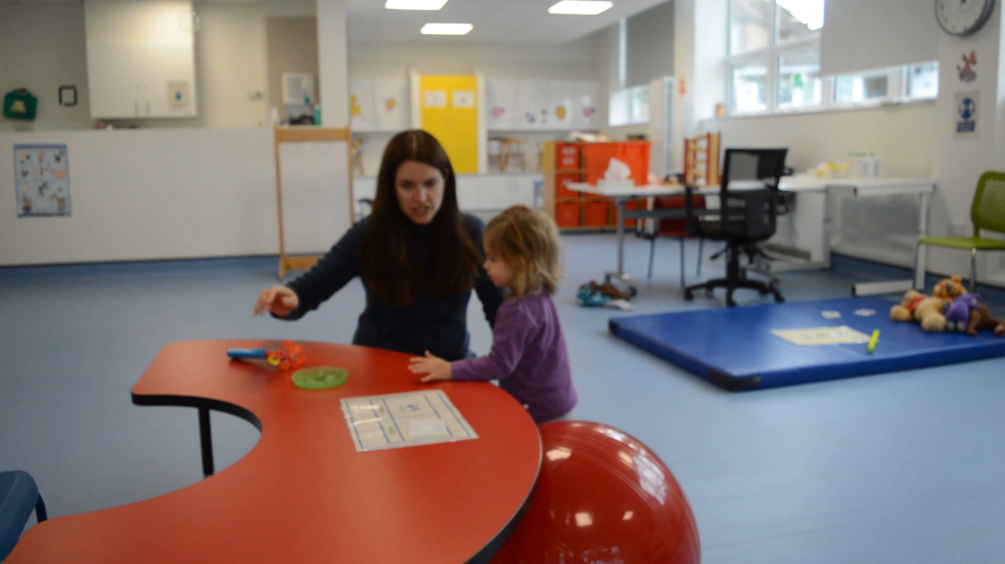
Click the play button under the image to view the video

Slide 4
Did you notice...
Mum said “First… Then…” to encourage Isla to join in with an adult led activity (gym ball), and then she would get a motivating activity (bubbles)
Mum supported what she was saying by using visuals (First and Then board)
Mum used positive language to encourage and reassure Isla e.g. “Mummy will look after you”
Isla was happy to sit on the gym ball with Mum’s support
Isla was then unsure about going on her tummy

Slide 5
Did you notice...
Watch the video again
What did Isla’s Mum do to encourage Isla to go on her tummy?

Slide 6
Watch again...

Slide 7
Did you notice...
Mum told Isla “Just three” so that she knew how long it was going to last.
Mum then focussed Isla’s attention back to the First and Then board to reassure her “First ball, then bubbles”.
This reminded Isla that she would get what she wanted (bubbles) after the ball.

Slide 8
How can I use this in real life?
Think about times when your child is finding it difficult to engage in an activity. Try using the ‘first/then’ approach in words and/or pictures to help them achieve a small task first before getting their desired activity:
First sitting then lunch
First book then iPad
First car then park
First teeth then story
First drawing then sticker
First apple then chocolate
First coat then play
First tidy then TV

